Slide 1
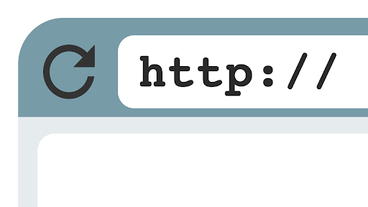
HTTP- Hypertext Transfer Protocol

Slide 2
HTTP is an application layer protocol designed within the framework of the Internet protocol suite. Its definition presumes an underlying and reliable transport layer protocol, thus Transmission Control Protocol (TCP) is commonly used.

Slide 3
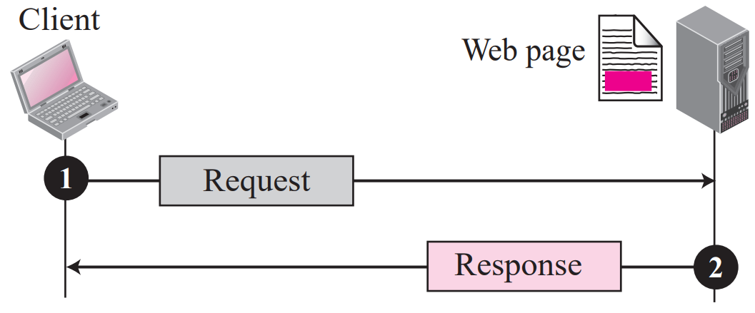
Example 1:- Assume we need to retrieve a Web page that contains the biography of a famous character with some pictures, which are embedded in the page itself. Since the pictures are not stored as separate files, the whole document is a simple Web page. It can be retrieved using one single request/ response transaction, as shown in Figure .

Slide 4
Example 2:- Now assume we need to retrieve a scientific document that contains one reference to another text file and one reference to a large image. Figure shows the situation. The main document and the image are stored in two separate files in the same site (file A and file B); the referenced text file is stored in another site (file C). Since we are dealing with three different files, we need three transactions if we want to see the whole document. The first transaction (request/response) retrieves a copy of the main document (file A), which has a reference (pointer) to the second and the third files. When a copy of the main document is retrieved and browsed, the user can click on the reference to the image to invoke the second transaction and retrieve a copy of the image (file B). If the user further needs to see the contents of the referenced text file, she can click on its reference (pointer) invoking the third transaction and retrieving a copy of the file C. Note that although files A and B both are stored in site I, they are independent files with different names and addresses. Two transactions are needed to retrieve them.

Slide 5
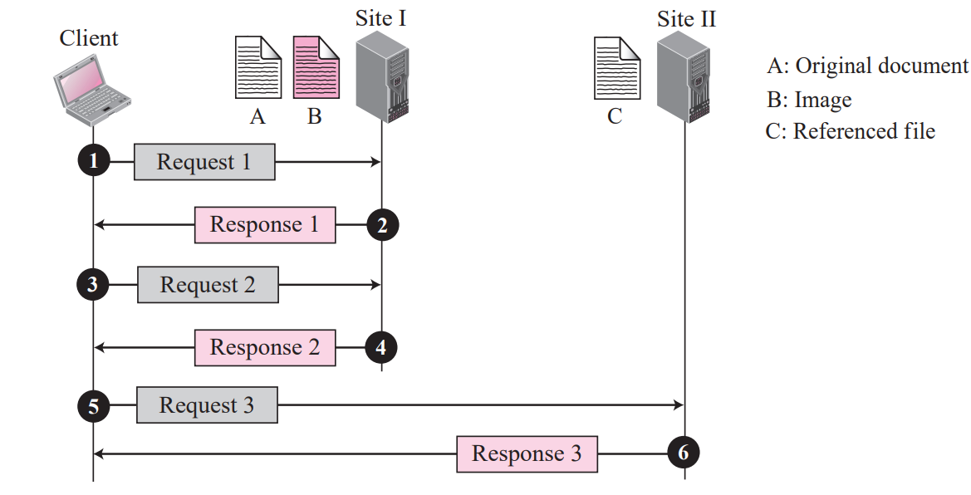

Slide 6
Example 3:- A very important point we need to remember is that file A, file B, and file C in Example 2 are independent Web pages, each with independent names and addresses. Although references to file B or C are included in file A, it does not mean that each of these files cannot be retrieved independently. A second user can retrieve file B with one transaction. A third user can retrieve file C with one transaction. Hypertext and Hypermedia The previous examples show the idea of hypertext and hypermedia. Hypertext means creating documents that refer to other documents. In a hypertext document, a part of text can be defined as a link to another document. When a hypertext is viewed with a browser, the link can be clicked to retrieve the other document. Hypermedia is a term applied to document that contains links to other textual document or documents containing graphics, video, or audio.

Slide 7
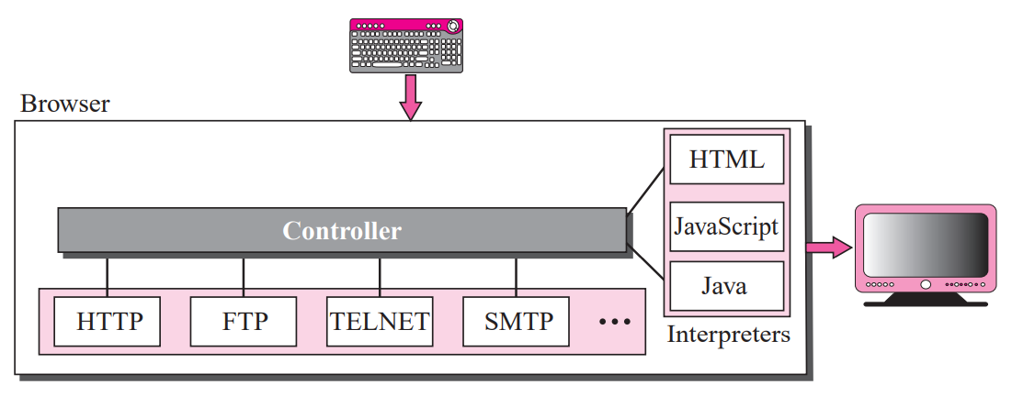
Web Client (Browser) A variety of vendors offer commercial browsers that interpret and display a Web document, and all of them use nearly the same architecture. Each browser usually consists of three parts: a controller, client protocol, and interpreters. (see Figure).

Slide 8
The controller receives input from the keyboard or the mouse and uses the client programs to access the document. After the document has been accessed, the controller uses one of the interpreters to display the document on the screen. The client protocol can be one of the protocols described previously such as FTP, or TELNET, or HTTP. The interpreter can be HTML, Java, or JavaScript, depending on the type of document. We discuss the use of these interpreters based on the document type later in the chapter. Some commercial browsers include Google Chrome, Firefox and Microsoft Edge.

